Slide 1
COMPARATIVE SITUATIONAL ANALYSIS OF JSON ALTERNATIVES
Joshua Moughler
Jacob Gnatz

Slide 2
OVERVIEW
Purpose Statement
Background
Serialization Alternatives
YAML
XML
BSON
UBJSON

Slide 3
PURPOSE
To understand the difference and use cases for JSON alternatives.

Slide 4
BACKGROUND
Definition: “JSON (JavaScript Object Notation) (RFC 7159) is a lightweight data-interchange format. It is easy for humans to read and write. It is easy for machines to parse and generate.” ^{[1]}

Slide 5
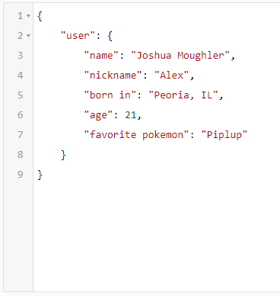
TRANSLATION
If you are trying to take some amount of data and move it from one language to another JSON does that.

Slide 6
ALTERNATIVES
YAML
XML
UBJSON
BSON

Slide 7
YAML
Definition: YAML (YAML Ain't Markup Language) “is a human friendly data serialization standard for all programming languages.” ^{[2]}

Slide 8
YAML COMPARATIVE ADVANTAGES
Designed for configuration
Supports Comments
Creator of JSON believed that comments were useless
Cross platform universal
Designed to be easily read and easily edited
JSON is designed to be easily read but not edited
Supports self referencing
Support for complex data types [3]

Slide 9
YAML COMPARATIVE DISADVANTAGES
JSON is designed for data interchange between various APIs
JSON is functionally less complex
Makes it an easier language to grasp as a whole

Slide 10
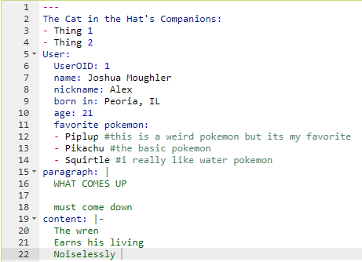
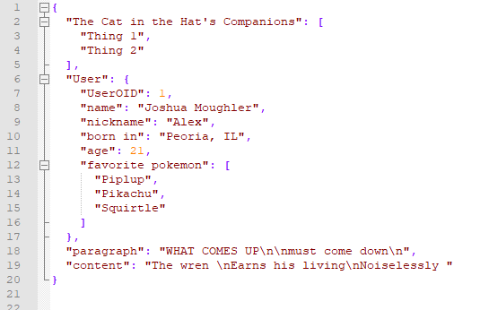
YAML VS JSON EXAMPLE

Slide 11
XML
Definition: XML (eXtensible Markup Language) is designed to store and transport data.

Slide 12
XML COMPARATIVE ADVANTAGES
XML can be parsed by an XML parser as well as other languages
JSON must be parsed by a JavaScript function
XML is displayed by browsers in a very readable way

Slide 13
XML COMPARATIVE DISADVANTAGES
JSON is less cryptic
JSON requires fewer characters to perform the same functions
JSON is an easier language to read and write
JSON can use Arrays

Slide 14
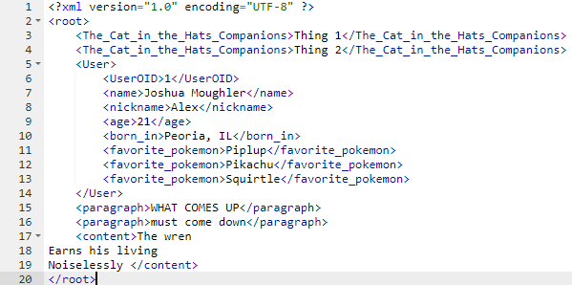
XML VS JSON EXAMPLE

Slide 15
UBJSON
Definition: UBJSON (Universal Binary JSON Specification) is a marker-based form of JSON data compressible to smaller binary formats.

Slide 16
UBJSON COMPARATIVE ADVANTAGES
UBJSON (on average) compresses JSON files to be 30% smaller in .ubj format
These gains can be even higher for some data types. [5]
UBJSON is 100% compatible with JSON data structures
UBJSON is still text legible for viewing purposes

Slide 17
UBJSON COMPARATIVE DISADVANTAGES
UBJSON is not standardized like JSON, requiring less-popular parsing tools
UBJSON is more difficult to manually edit (due to strict markup)
UBJSON adds no additional utility beyond standard JSON spec (although this can also be considered an advantage)

Slide 18
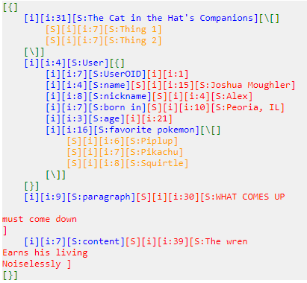
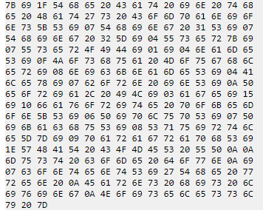
UBJSON VS JSON EXAMPLE
Binary equivalent format compressed to hexadecimal

Slide 19
BSON
Definition: BSON (Binary JSON) is a binary-based serialization format for data documents similar to JSON. It is the primary data-representation for MongoDB (database service company).

Slide 20
BSON COMPARATIVE ADVANTAGES
BSON can quickly be encoded and decoded “in most languages due to the use of C data types” [6]
BSON is specialized to be space-efficient and facilitates fast scanning + traversal
BSON has additional data types from standard JSON spec (date type, byte-array type)

Slide 21
BSON COMPARATIVE DISADVANTAGES
BSON is even less popular than UBJSON, and common parsers are often not optimized for BSON decoding
Encoded BSON is not human readable, even in plaintext
In some cases, BSON can take up more space than JSON (due to additional traversability info) [7]
BSON files are not able to be translated back to JSON if they contain BSON-specific data types

Slide 22
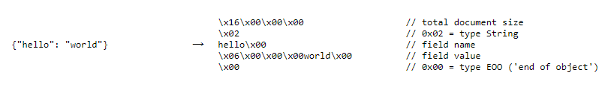
BSON VS JSON EXAMPLE

Slide 23
SOURCES
https://www.json.org/
http://yaml.org/
https://www.json2yaml.com/yaml-vs-json
https://www.w3schools.com/js/js_json_xml.asp
http://ubjson.org/
http://bsonspec.org/
http://bsonspec.org/faq.html

